Slide 1

CAPSTONE PROJECT
SECURE DATA HIDING IN IMAGE USING STEGANOGRAPHY
Presented By:
Student Name : Vappangi Roshitha
College Name : Maharaj Vijayaram Gajapathi Raj College of Engineering (Autonomous)
Department : CSIT

Slide 2
OUTLINE
Problem Statement
Technology used
Wow factor
End users
Result
Conclusion
Git-hub Link
Future scope

Slide 3
Problem Statement
With the increasing need for data privacy and secure communication, traditional encryption methods may draw unwanted attention. Steganography allows users to hide secret messages inside images, making the communication discreet and undetectable.
This project aims to develop a secure and user-friendly steganography tool that allows users to encode and decode hidden messages within images, ensuring data confidentiality and integrity.

Slide 4
Technology used
Programming Language: Python
Libraries Used:
OpenCV (Image Processing)
NumPy (Data Handling)
Argparse (Command-line interaction)
File Handling: Text File Storage for decoded messages
Steganography Concept: LSB (Least Significant Bit) Encoding

Slide 5
Wow factors
✔️ User-Friendly Message Encoding: Users can enter multiple secret messages.
✔️ Persistent Storage: Decoded messages are saved in decoded_message.txt for future reference.
✔️ Lossless Image Steganography: Original image quality is preserved.
✔️ Supports Special Characters & Emojis: Uses UTF-8 encoding for universal character support.
✔️ Unnoticeable Encryption: Unlike traditional encryption, this method keeps the image visually

Slide 6
End users
Individuals who need to share confidential data securely.
Cybersecurity Enthusiasts interested in secure communication techniques.
Researchers & Students exploring digital steganography.
Businesses & Journalists for discreet data exchange.

Slide 7
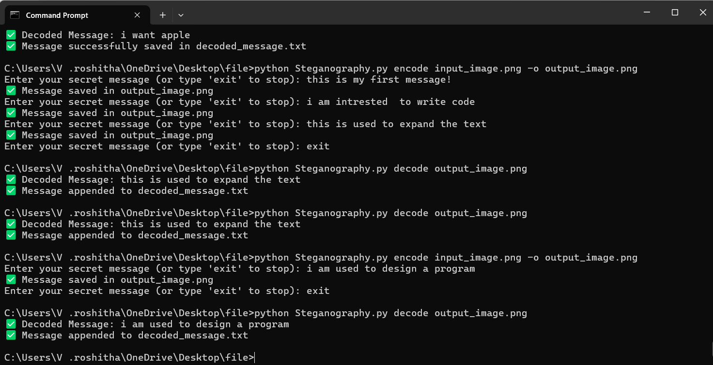
Results

Slide 8
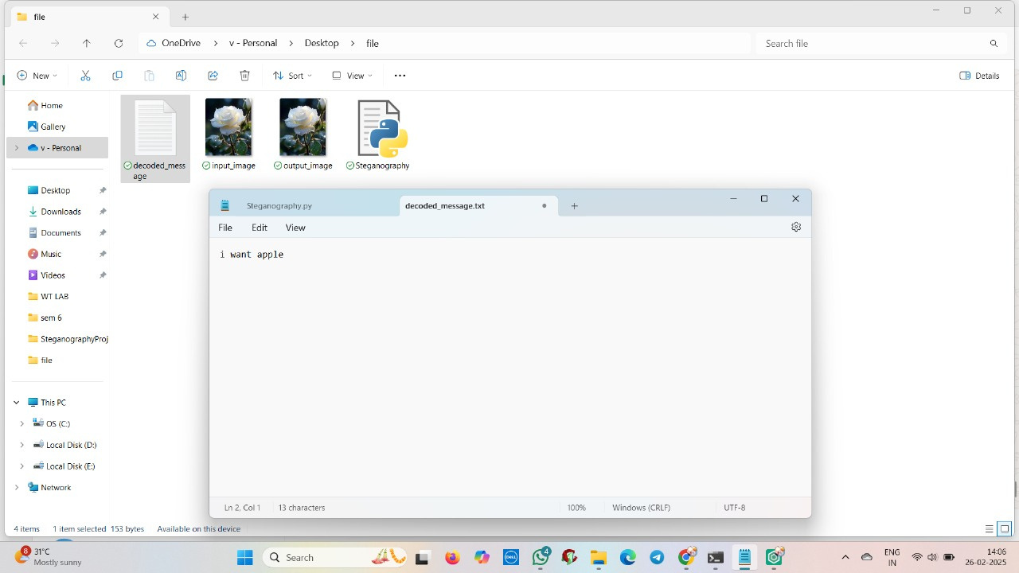

Slide 9
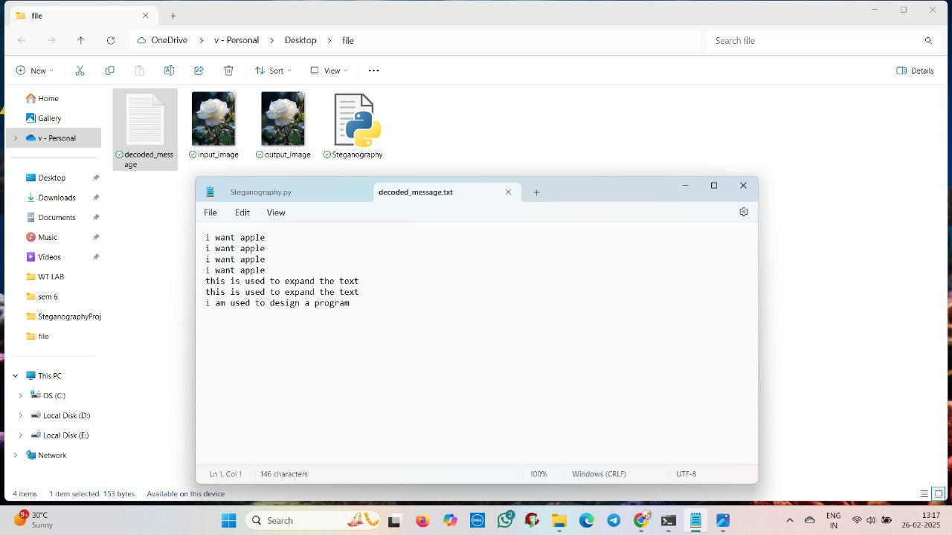

Slide 10
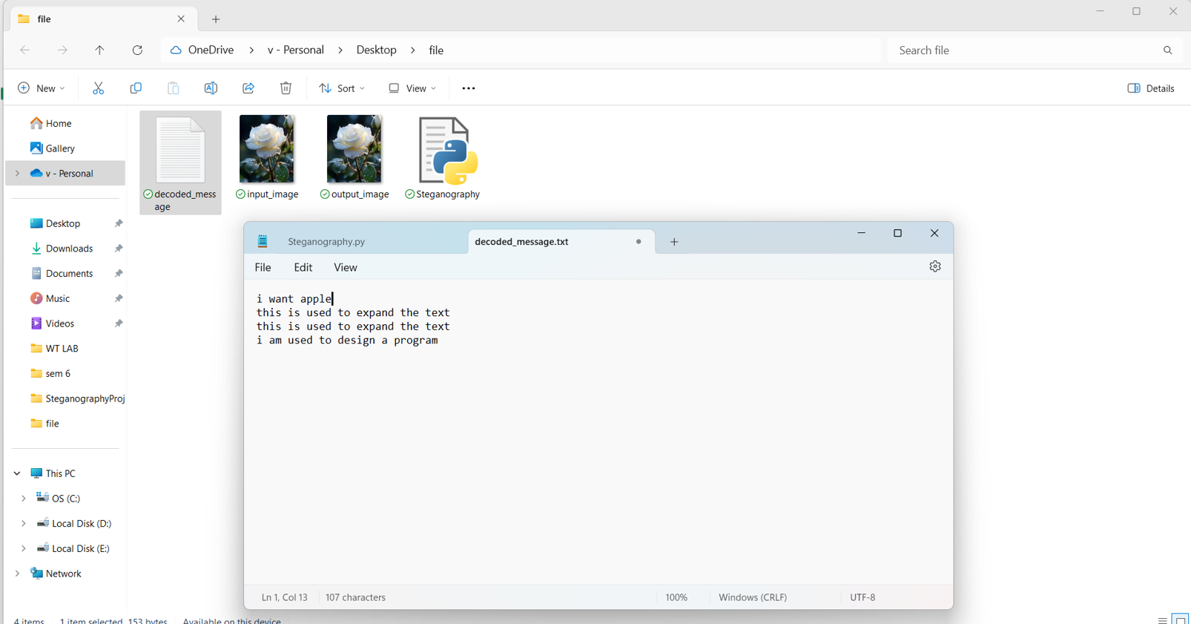

Slide 11
Conclusion
This project demonstrates the practical use of steganography for secure communication. By embedding messages inside images, it provides a hidden yet effective way to share sensitive information. The implemented Least Significant Bit (LSB) encoding technique ensures that messages remain undetectable to unintended viewers.
The project can be further expanded with password protection, multi-image encoding, or AI-driven detection techniques.

Slide 12
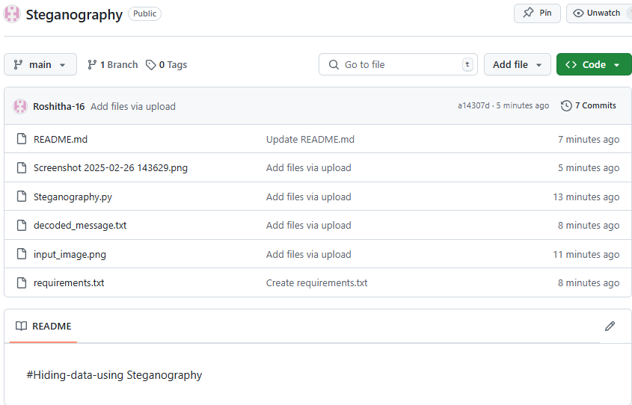
GitHub Link
https://github.com/Roshitha-16/Steganography.git

Slide 13
Future scope(optional):
Advanced Image Steganography– Implement more sophisticated algorithms like (LSB) in color channels.
🔹Audio/Video Steganography – Extend the project to hide messages in audio or video files.
🔹Encrypted Steganography – Add AES encryption for extra security.
🔹Steganalysis Protection – Improve resistance against steganalysis tools.
🔹Steganography Mobile App – Develop an Android/iOS app for secure mobile communication.

Slide 14
THANK YOU

